Slide 1

INFO 6150 Final Group Project: Roommate Connector
By: <codeBiryani >
<Kartik kumar />
<ASHRITH PRADEEP />
<vanita pandit />
<kiran kumar gangadharaiah />
</codeBiryani>

Slide 2

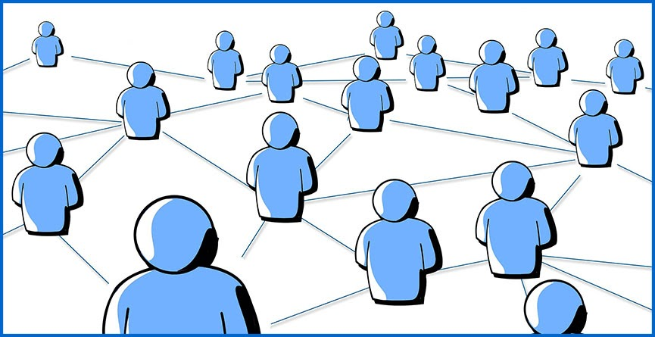


The Idea
Roommate Connector
This Photo by Unknown Author is licensed under CC BY-NC-ND

Slide 3
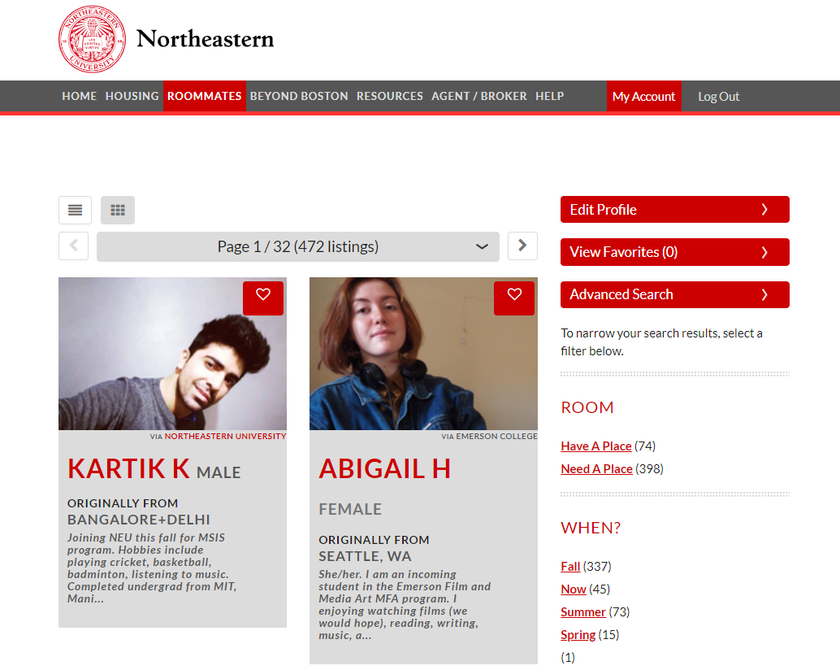

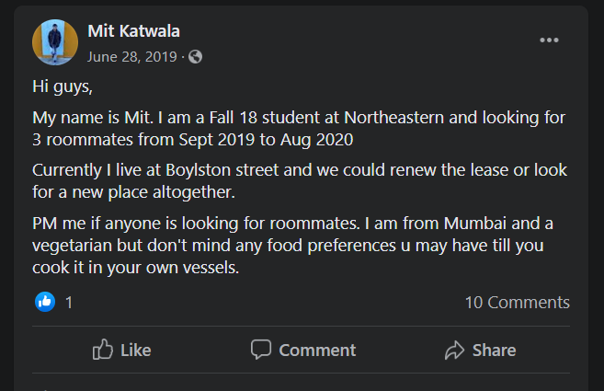
The Problem:
Finding a roommate / flat-mate isn’t easy. Especially, when you are moving to a new city/country.

Slide 4

The Solution
We’ve built a platform that allows students to connect with other like-minded individuals. Some of the key features of our app are:
Students can create a profile for themselves with basic background info which will be visible to others
Students can browse through other’s profiles to find their match
Students can post their requirements on Post feed
Students can like/unlike/comment on other’s posts

Slide 5




Approach

Slide 6
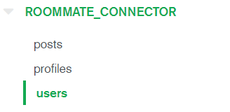
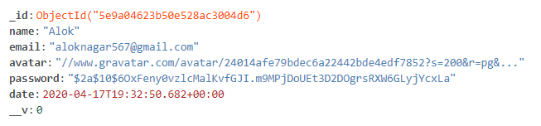

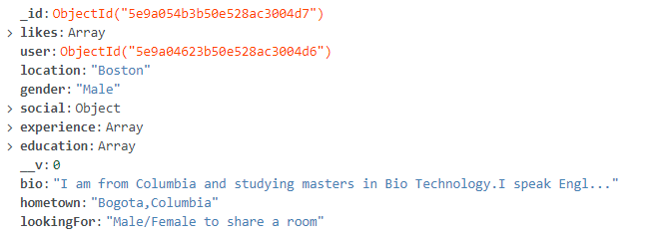
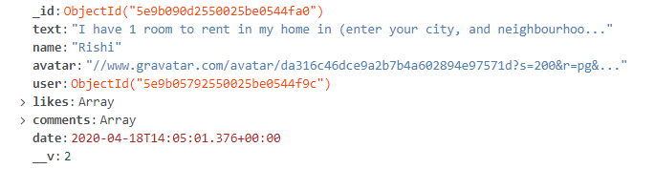
Schema Design
Users Schema
Profile Schema
Posts Schema

Slide 7
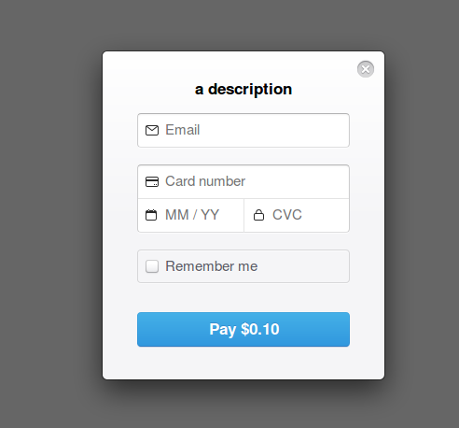
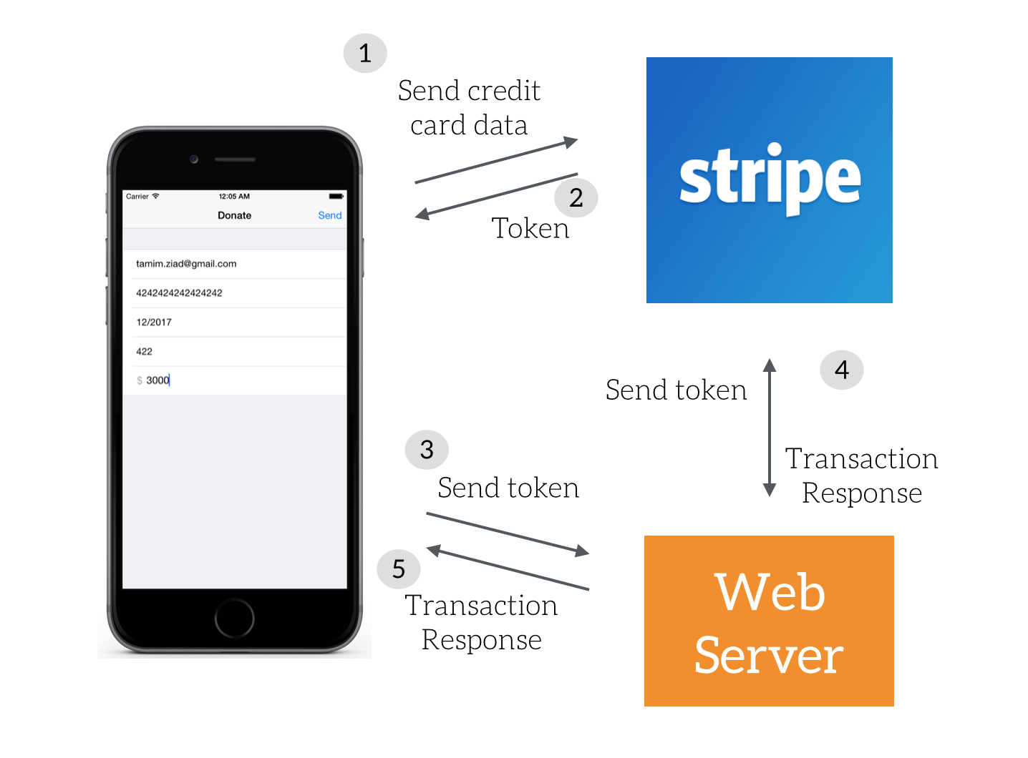

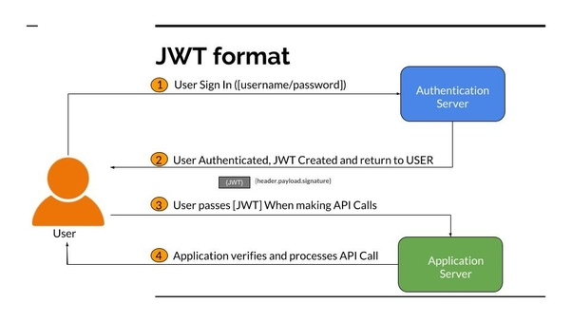

Other Technologies used
This Photo by Unknown Author is licensed under CC BY-SA
This Photo by Unknown Author is licensed under CC BY-SA
This Photo by Unknown Author is licensed under CC BY-SA

Slide 8
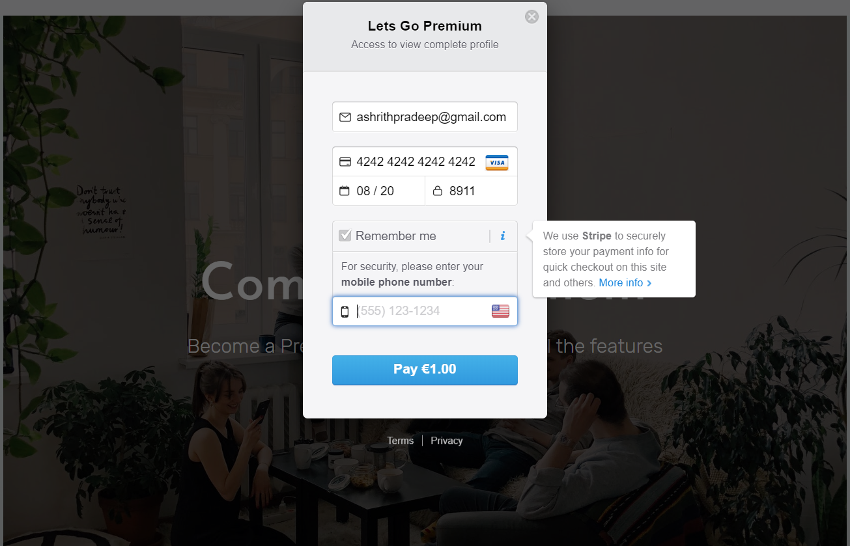
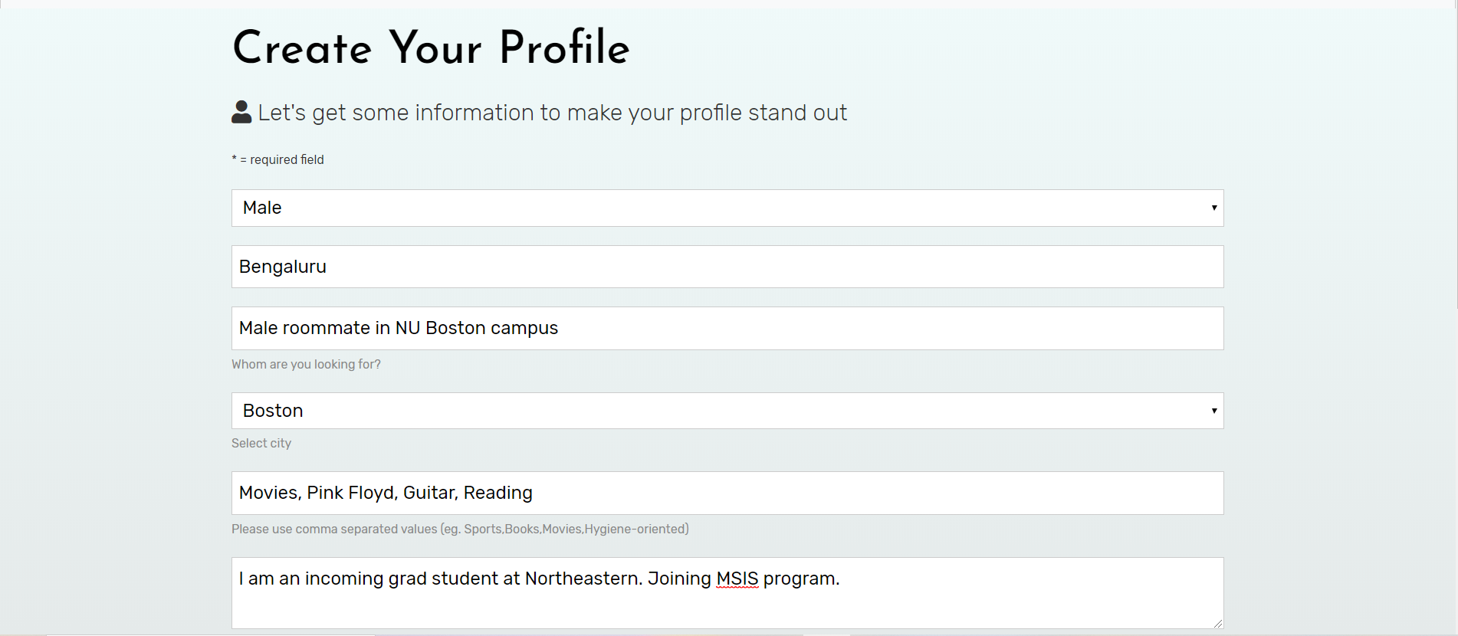
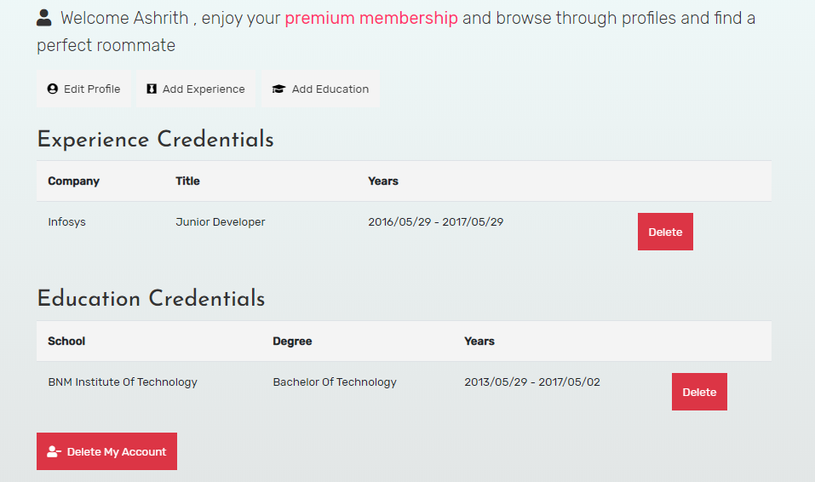
Screenshots of Main Features
Make Payment
Create Profile
Edit/Delete Profile
Pay a minimal amount to be part of the community
Add your personal details and preferences in your profile
Edit/delete your profile. Add/remove any professional experience, education history

Slide 9
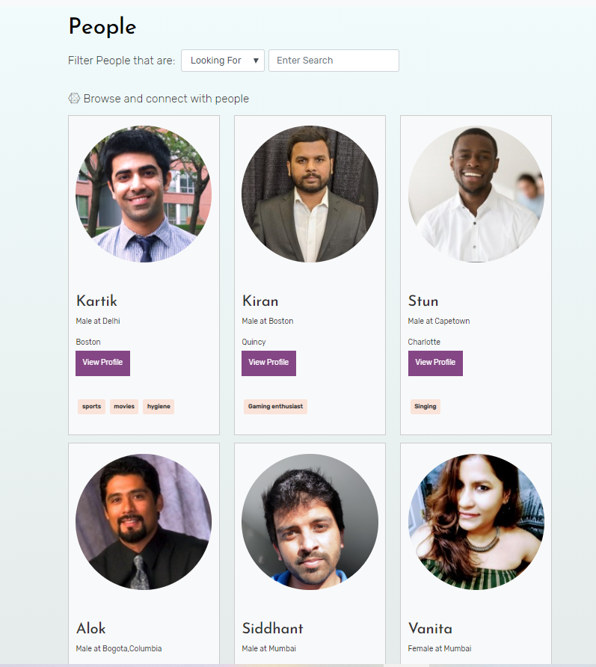
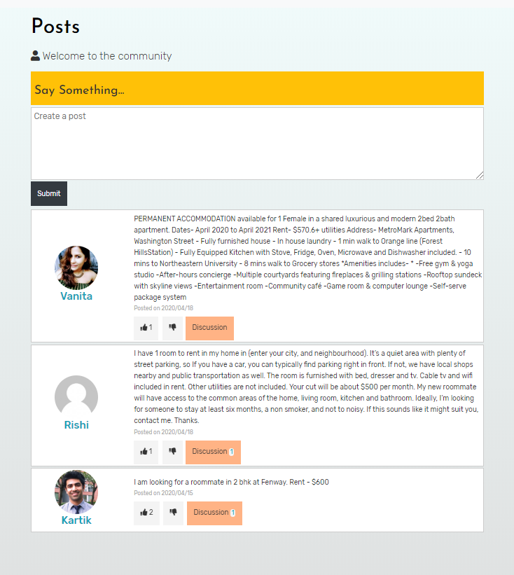
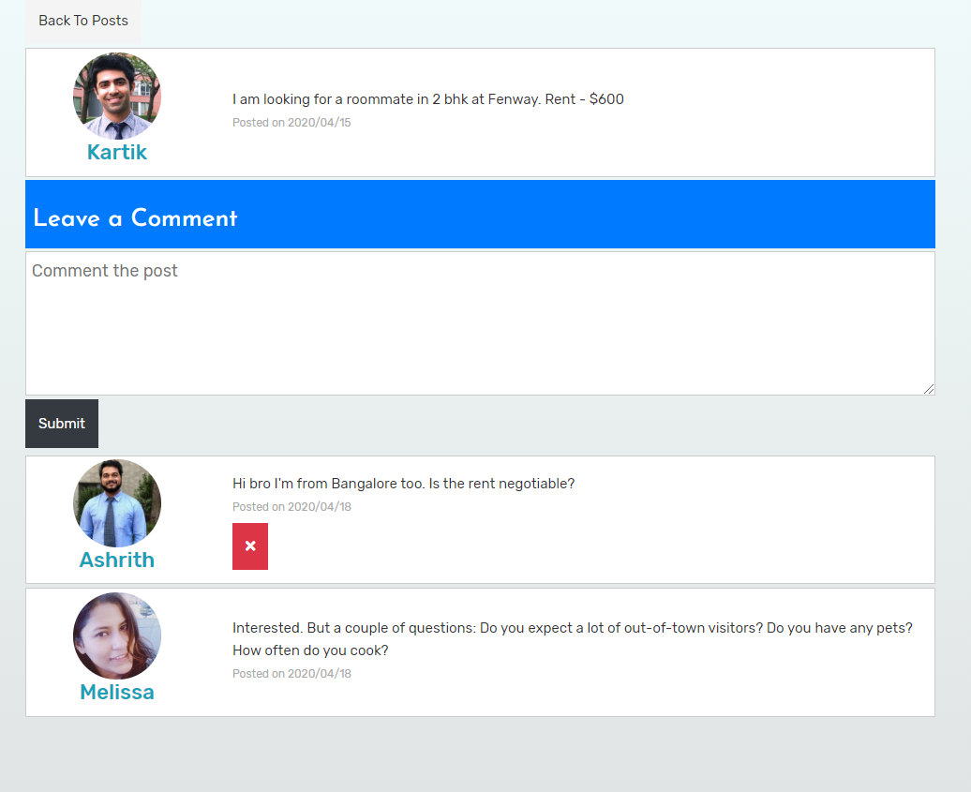
Screenshots of Main Features
View Profiles List
View/Like Posts
Comment on Post
View a listing of all the people on our platform. Filter based on location, gender, preferences
View a listing of all the people on our platform. Filter based on location, gender, preferences,
Add Education history to your profile

Slide 10

ONTO THE LIVE DEMO..
This Photo by Unknown Author is licensed under CC BY-NC-ND

